Slide 1

CISCO Competition
By
Eylon Naamat
&
Michael Matveev

Slide 2
Start of the work
First, we downloaded the example notebook and the datasets from the github.
After reviewing the basic code and understanding what the basic algorithm is we started to look how we can improve the learning.
The first thing we noticed was that improving the features increases the success rate, so we decided to check features by doing data exploration.

Slide 3

Data Exploration

Slide 4
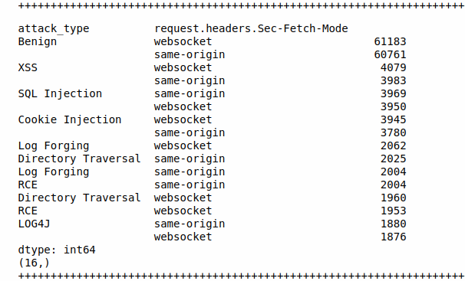
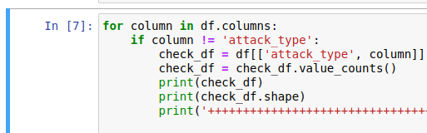
At the beginning we checked for every feature how its values are divided in relation to the attack type label.

Slide 5
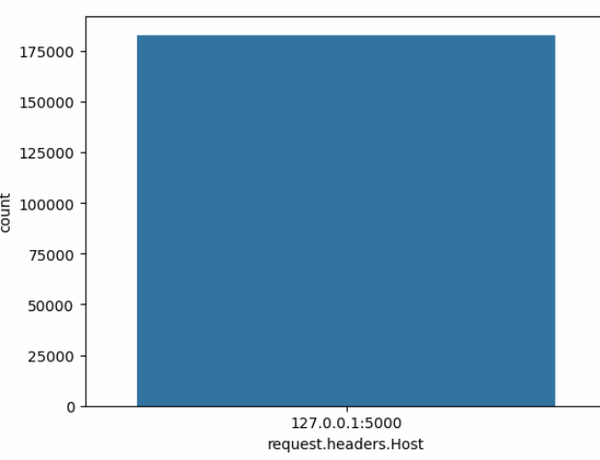
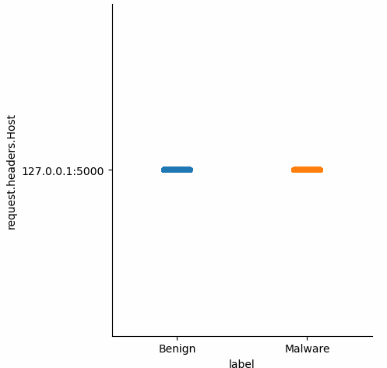
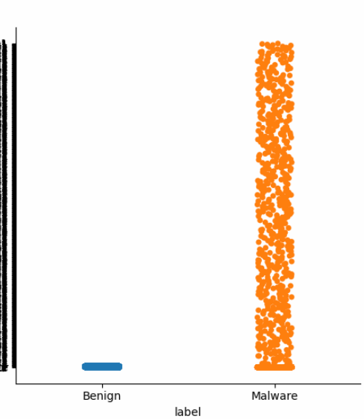
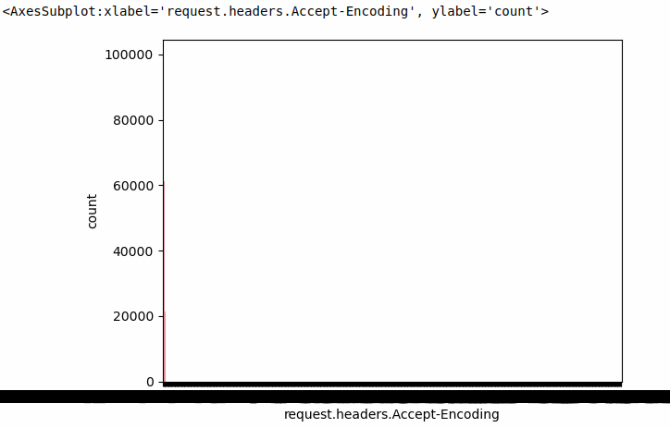
Bad
Features
Good
Features

Slide 6
Good Features
Bad Features
request.headers.Accept-Encoding
request.method
request.headers.Accept-Language
request.headers.Sec-Fetch-Site
request.headers.Sec-Fetch-Mode
request.headers.Sec-Fetch-Dest
request.headers.Sec-Fetch-User
response.status_code
'request.headers.User-Agent
request.headers.Set-Cookie
request.url
response.body
response.headers.Location
request.headers.Content-Length
request.headers.Cookie
request.headers.Upgrade-Insecure-Requests
request.body
request.headers.Date
request.headers.Host
request.headers.Accept
request.headers.Connection
request.headers.Sec-Fetch-User
response.status
response.headers.Content-Type
response.headers.Set-Cookie
request.headers.Sec-Ch-Ua-Platform
request.headers.Sec-Ch-Ua-Mobile
request.headers.Cache-Control

Slide 7
Second try
We then tried to run the Random Forest Classifier with the selected features shown previously to train our model.
And the results were better but not that great.
We decide to improve our learning.
We went back to the data exploration and examined every kind of attack by itself and its features (same as before but for every attack by itself).

Slide 8

Creating Features

Slide 9
Log4j
First, we wanted to know what is common to all the log4j attacks.
we went through the columns in which the attack_type is log4j and compare it to the benign column.

Slide 10
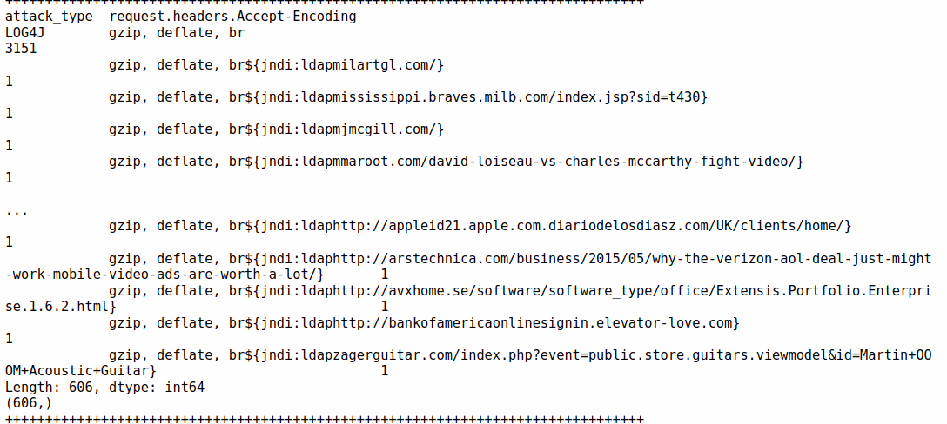
we discovered that the symbols ${ appear in the next columns mostly in LOG4J attack type:
request.headers.Accept-Encoding
request.headers.Set-Cookie
request.headers.Sec-Fetch-Site
request.headers.Sec-Fetch-Dest

Slide 11
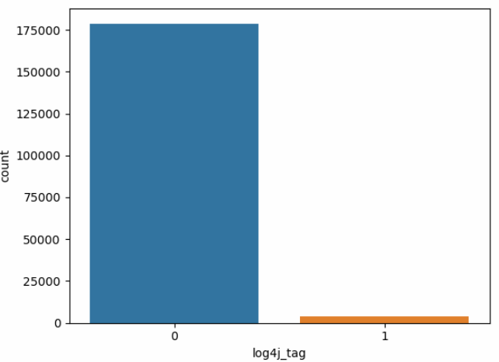
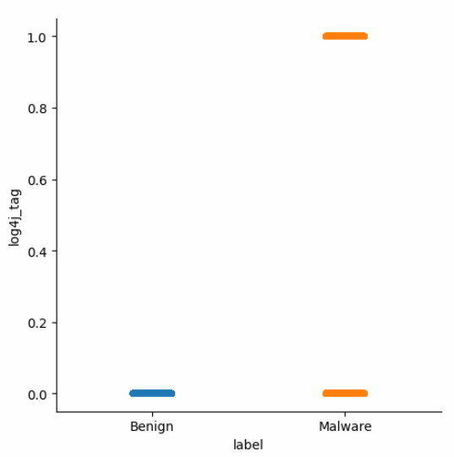

Slide 12
SQL Injection
First, we wanted to know what is common to all the SQL Injection attacks.
we went through the columns in which the attack_type is sql injection and compare it to the benign column.

Slide 13
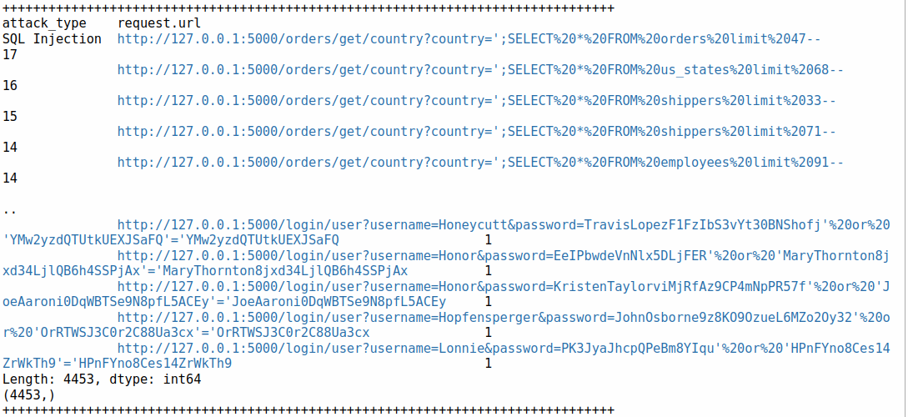
We discovered that the symbols %20 appear in the request.url column mostly in SQL Injection attack type.

Slide 14
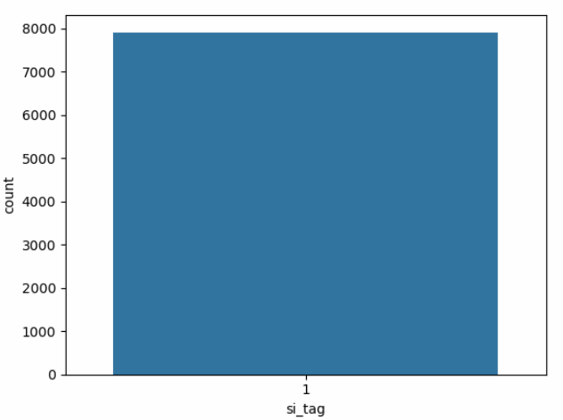
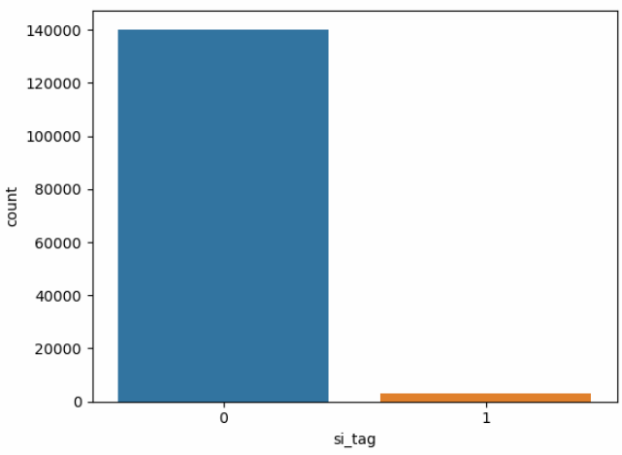
SQL Injection Benign

Slide 15
Directory Travesal
First, we wanted to know what is common to all the Directory Traversal attacks.
we went through the columns in which the attack_type is directory traversal and compare it to the benign column.

Slide 16
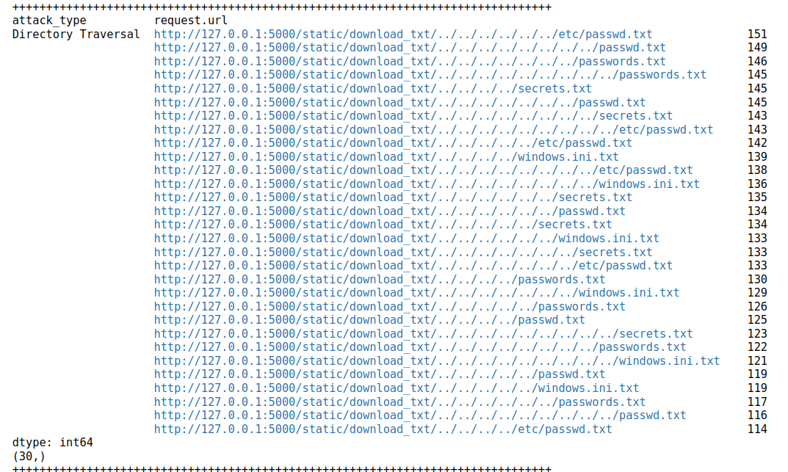
We discovered that the symbols /.. appear in the request.url column mostly in Directory Traversal attack type.

Slide 17
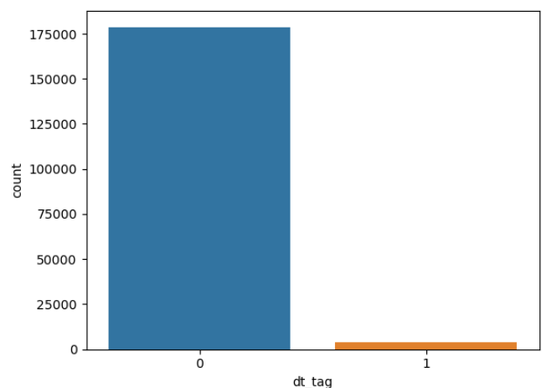
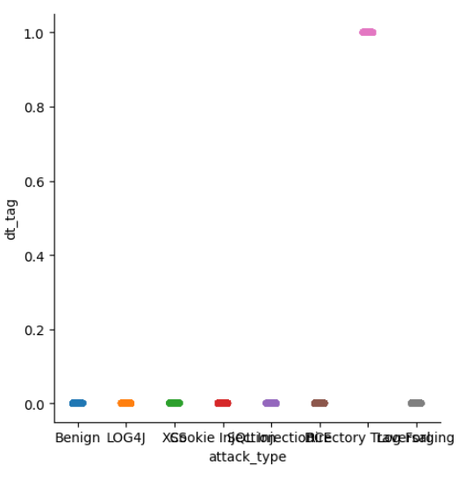
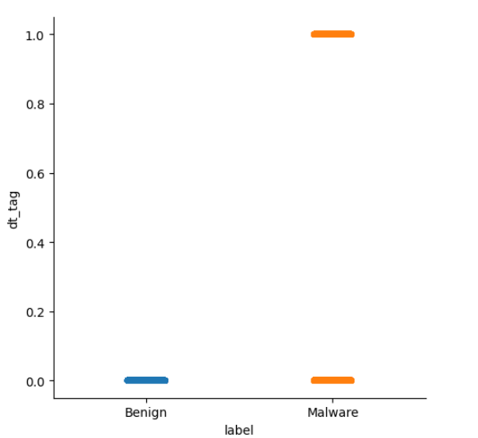

Slide 18
XSS
First, we wanted to know what is common to all the XSS attacks.
we went through the columns in which the attack_type is xss and compare it to the benign column.

Slide 19
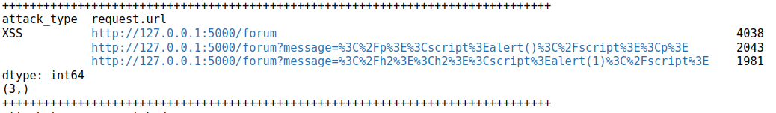
We discovered that the symbols /forum appear in the request.url column mostly in XSS attack type.

Slide 20
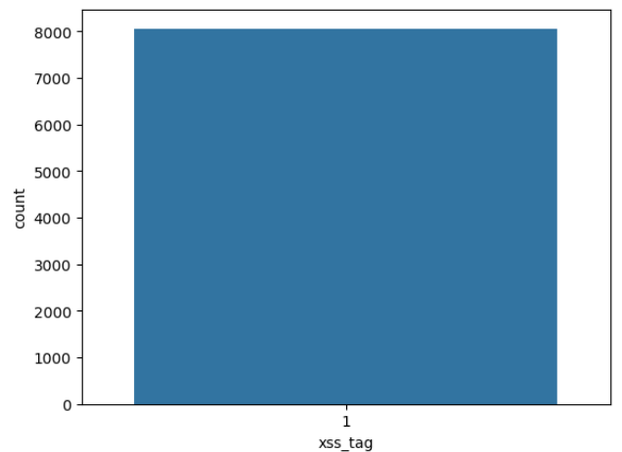
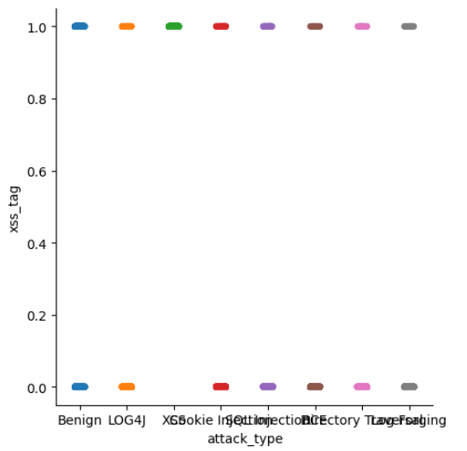
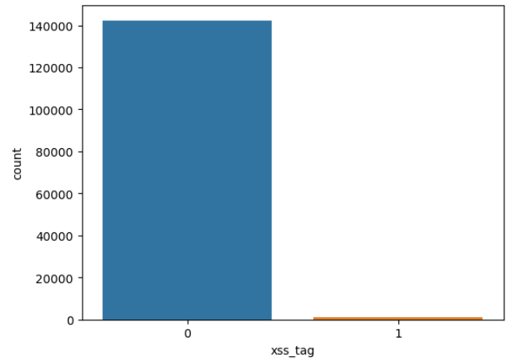

Slide 21

Combine all together

Slide 22
Algorithm
After we decided upon the features, we started to examine the algorithm.
We chose to work with the Random Forest Classifier, we split the features to 2 kinds – simple and complex.
We removed the unnecessary features we mentioned previously.
We used the label encode for the simple features.
We used the hashing vectorizer for the complex features.
Then, we created a Random Forest Classifier with n_estimators of 170.
We split the dataset to 80% train and 20% test and trained our model.

Slide 23
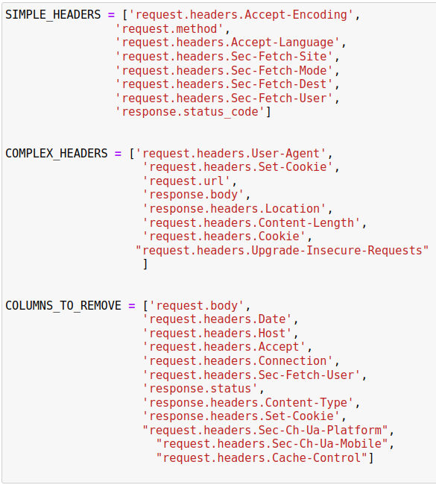
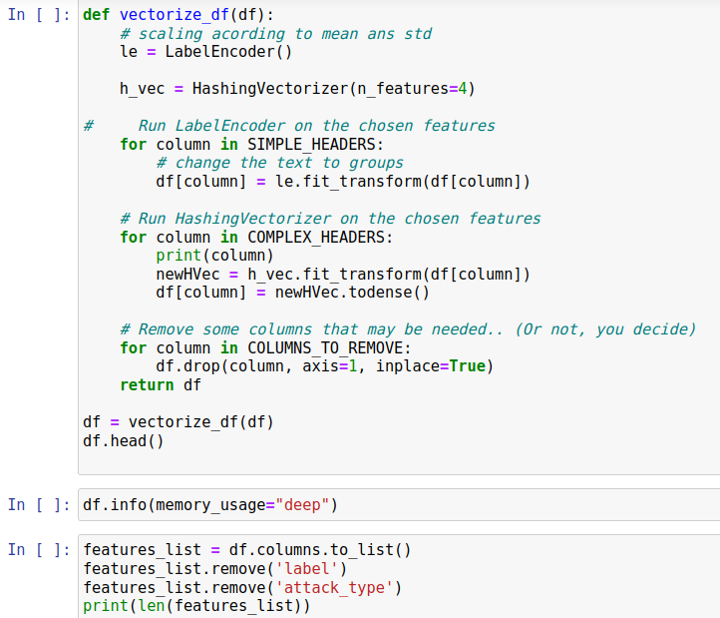

Slide 24
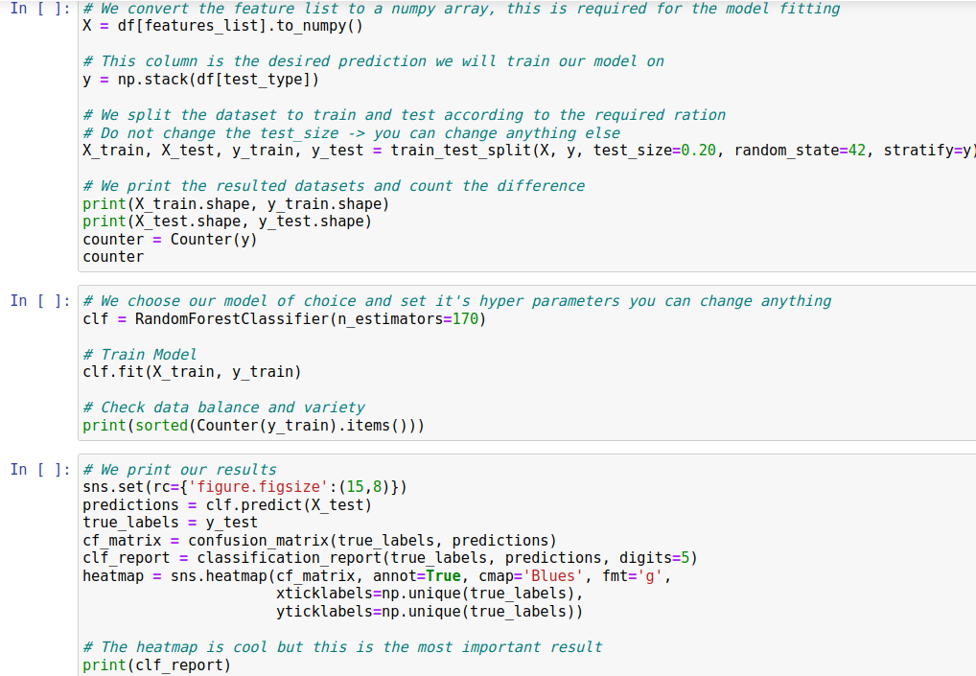

Slide 25
